Slide 1

Network Programming Paradigm

Slide 2
Introduction
Introduction
Network paradigm involves a client and a server
Server: provides information and waits for a client
Client: need some information
A client connects to a server and queries certain information
Server sends a response to the client for the asked query
Internet scenario; client runs on a desktop/laptop attached to the internet browsing for information
Servers run on a larger powerful computers with information
Web is made of a group of computers that act as web servers; has vast amounts of HTML tags, pages and data available for people to retrieve and browse
Web clients connect to these web servers and browse through the web pages
Network programming uses a particular type of network communication known as sockets. Socket is a software abstraction for an input or output medium of communication

Slide 3
What is Socket?
A socket is a software abstraction for an input or output medium of communication.
Sockets allow communication between processes that lie on the same machine, or on different machines working in diverse environment and even across different continents.
A socket is the most vital and fundamental entity. Sockets are the end-point of a two-way communication link.
An endpoint is a combination of IP address and the port number.
For Client-Server communication,
Sockets are to be configured at the two ends to initiate a connection,
Listen for incoming messages
Send the responses at both ends
Establishing a bidirectional communication.

Slide 4
Client
Server
192.168.200.200, 9999
Request
192.168.200.1, 9999
Tx
Rx
Response
Rx
Tx

Slide 5
Socket Types
Datagram Socket
A datagram is an independent, self-contained piece of information sent over a network whose arrival, arrival time, and content are not guaranteed. A datagram socket uses User Datagram Protocol (UDP) to facilitate the sending of datagrams (self-contained pieces of information) in an unreliable manner. Unreliable means that information sent via datagrams isn't guaranteed to make it to its destination.
Stream Socket:
A stream socket, or connected socket, is a socket through which data can be transmitted continuously. A stream socket is more akin to a live network, in which the communication link is continuously active. A stream socket is a "connected" socket through which data is transferred continuously.

Slide 6
Socket in Python
sock_obj = socket.socket( socket_family, socket_type, protocol=0)
socket_family: - Defines family of protocols used as transport mechanism.
Either AF_UNIX, or
AF_INET (IP version 4 or IPv4).
socket_type: Defines the types of communication between the two end-points.
SOCK_STREAM (for connection-oriented protocols, e.g., TCP), or
SOCK_DGRAM (for connectionless protocols e.g. UDP).
protocol: We typically leave this field or set this field to zero.
Example:
#Socket client example in python
import socket
#create an AF_INET, STREAM socket (TCP)
s = socket.socket(socket.AF_INET, socket.SOCK_STREAM)
print 'Socket Created'

Slide 7
Socket Creation
import socket
import sys
try:
#create an AF_INET, STREAM socket (TCP)
s = socket.socket(socket.AF_INET, socket.SOCK_STREAM)
except socket.error, msg:
print 'Failed to create socket. Error code: ' + str(msg[0]) + ' , Error message : ' + msg[1]
sys.exit();
print 'Socket Created'

Slide 8
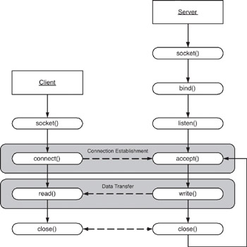
Client/server symmetry in Sockets applications

Slide 9
Socket in Python
To create a socket, we must use socket.socket() function available in the Python socket module, which has the general syntax as follows:
S = socket.socket(socket_family, socket_type, protocol=0)
socket_family: This is either AF_UNIX or AF_INET. We are only going to talk about INET sockets, as they account for at least 99% of the sockets in use.
socket_type: This is either SOCK_STREAM or SOCK_DGRAM.
Protocol: This is usually left out, defaulting to 0.
Client Socket Methods
Following are some client socket methods:
connect( ) : To connect to a remote socket at an address. An address format(host, port) pair is used for AF_INET address family.

Slide 10
Socket in Python
Server Socket Methods
bind( ): This method binds the socket to an address. The format of address depends on socket family mentioned above(AF_INET).
listen(backlog) : This method listens for the connection made to the socket. The backlog is the maximum number of queued connections that must be listened before rejecting the connection.
accept( ) : This method is used to accept a connection. The socket must be bound to an address and listening for connections. The return value is a pair(conn, address) where conn is a new socket object which can be used to send and receive data on that connection, and address is the address bound to the socket on the other end of the connection.

Slide 11
General Socket in Python
sock_object.recv():
Use this method to receive messages at endpoints when the value of the protocol parameter is TCP.
sock_object.send():
Apply this method to send messages from endpoints in case the protocol is TCP.
sock_object.recvfrom():
Call this method to receive messages at endpoints if the protocol used is UDP.
sock_object.sendto():
Invoke this method to send messages from endpoints if the protocol parameter is UDP.
sock_object.gethostname():
This method returns hostname.
sock_object.close():
This method is used to close the socket. The remote endpoint will not receive data from this side.

Slide 12
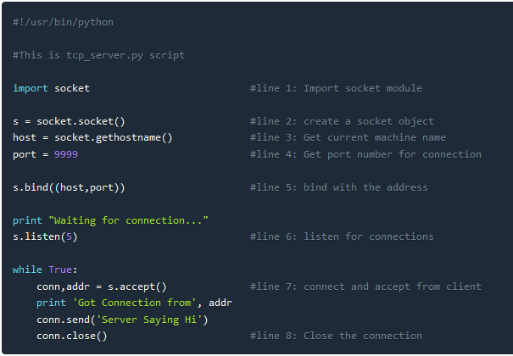
Simple TCP Server

Slide 13
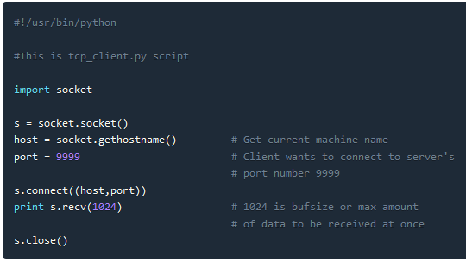
Simple TCP Client

Slide 14
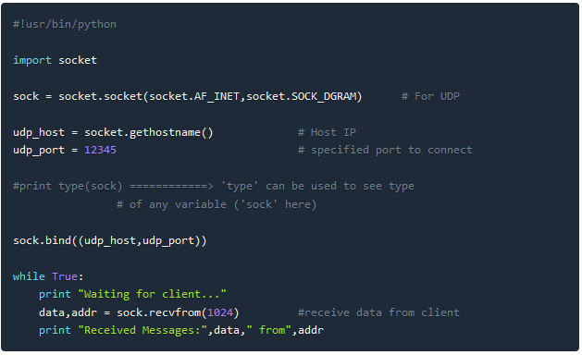
Simple UDP Server

Slide 15
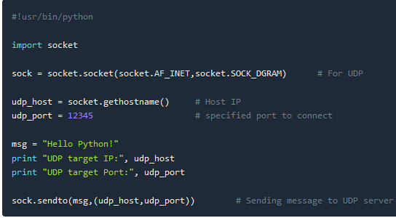
Simple UDP Client

